Slide 1
Simplify Your Science with Workflow Tools
International HPC Summer School
June 27, 2017
Scott Callaghan
Southern California Earthquake Center
University of Southern California
scottcal@usc.edu

Slide 2
Overview
What are scientific workflows?
What problems do workflow tools solve?
Overview of available workflow tools
CyberShake (seismic hazard application)
Computational overview
Challenges and solutions
Ways to simplify your work
Goal: Help you figure out if this would be useful

Slide 3
Scientific Workflows
Formal way to express a scientific calculation
Multiple tasks with dependencies between them
No limitations on tasks
Capture task parameters, input, output
Independence of workflow process and data
Often, run same workflow with different data
You use workflows all the time…

Slide 4
Perhaps your workflow is simple…
stage-in
parallel job
post-process
stage-out

Slide 5
…or maybe a bit more complicated…
Job 1
pre-process
Job 2
visualize
publish
Job 3
Job 4

Slide 6
…or maybe just confusing
edit file names
stage-in
post-process again if it failed
stage-out
parallel job
post-process
stage-in that other file
do you still need this job?
job you always forget
job from past post-doc
email your supervisor

Slide 7
Workflow Components
Task executions
Specify a series of tasks to run
Data and control dependencies between tasks
Outputs from one task may be inputs for another
Task scheduling
Some tasks may be able to run in parallel with other tasks
File and metadata management
Track when a task was run, key parameters
Resource provisioning (getting cores)
Computational resources are needed to run jobs

Slide 8
What do we need help with?
Task executions
What if something fails in the middle?
Data and control dependencies
Make sure inputs are available for tasks
Task scheduling
Minimize execution time while preserving dependencies
Metadata
Automatically capture and track
Getting cores

Slide 9
Workflow tools can help!
Automate your pipeline
Define your workflow via programming or GUI
Run workflow on local or remote system
Can support all kinds of workflows
Use existing code (no changes)
Provide many kinds of fancy features and capabilities
Flexible but can be complex
Will discuss one set of tools (Pegasus) as example, but concepts are shared

Slide 10
Pegasus-WMS
Developed at USC’s Information Sciences Institute
Used in many domains, including LIGO project
Workflows are executed from local machine
Jobs can run on local machine or on distributed resources
You use API to write code describing workflow (“create”)
Python, Java, Perl
Tasks with parent / child relationships
Files and their roles
Pegasus creates XML file of workflow called a DAX
Workflow represented by directed acyclic graph

Slide 11
Sample Workflow
input.txt
//Create DAX object
dax = ADAG("test_dax")
//Define my job
myJob = Job(name="my_job")
//Input and output files to my job
inputFile = File("input.txt")
outputFile = File("output.txt")
//Arguments to my_job (./my_job input=input.txt output=output.txt)
myJob.addArgument("input=input.txt", "output=output.txt")
//Role of the files for the job
myJob.uses(inputFile, link=Link.INPUT)
myJob.uses(outputFile, link=Link.OUTPUT)
//Add the job to the workflow
dax.addJob(myJob)
//Write to file
fp = open("test.dax", "w")
dax.writeXML(fp)
fp.close()
my_job
output.txt

Slide 12
Getting ready to run (“Planning”)
DAX is “abstract workflow”
Logical filenames and executables
Algorithm description
Use Pegasus to “plan” workflow for execution
Uses catalogs to resolve logical names, compute info
Pegasus automatically augments workflow
Staging jobs (if needed) with GridFTP or Globus Online
Registers output files in a catalog to find later
Wraps jobs in pegasus-kickstart for detailed statistics
Generates a DAG
Top-level workflow description (tasks and dependencies)
Submission file for each job

Slide 13
Pegasus Workflow Path
Create workflow description (you write this)
Jobs Execute
Plan
Run
DAX API
Scheduler
(HTCondor)
Abstract workflow (DAX)
Logical names, algorithm
Concrete workflow (DAG)
Physical paths, job scripts

Slide 14
Other tools in stack
HTCondor (UW Madison)
Pegasus ‘submits’ workflow to HTCondor
Supervises runtime execution of DAG files
Maintains queue
Monitors dependencies
Schedules jobs
Retries failures
Writes checkpoint
GRAM (Globus Toolkit)
Uses certificate-based authentication for remote job submission
Supported by many HPC resources

Slide 15
Full workflow stack
Local machine
Remote machine
What you do:
Create workflow description
Remote scheduler
What the tools do:
HTCondor
Pegasus
GRAM
local queue
remote queue
DAG

Slide 16
Other Workflow Tools
Regardless of the tool, trying to solve same problems
Describe your workflow (Pegasus “Create”)
Prepare your workflow for the execution environment (Pegasus “Plan”)
Send jobs to resources (HTCondor, GRAM)
Monitor the execution of the jobs (HTCondor DAGMan)
Brief overview of some other available tools

Slide 17
Other Workflow Tools
Swift (U of Chicago)
Workflow defined via scripting language
Workflow compiled internally and executed
Focus on large data, many tasks
Askalon (U of Innsbruck)
Create workflow description
Use workflow language
Or use UML editor to graphically create
Conversion: like planning, to prep for execution
Submit jobs to Enactment Engine, which distributes jobs for execution at remote grid or cloud sites
Provides monitoring tools
//Create new type
type messagefile;
//Create app definition, returns messagefile
app (messagefile t) greeting() {
//Print and pipe stdout to t
echo “Hello, world!” stdout=@filename(t);
}
//Create a new messagefile, linked to hello.txt
messagefile outfile <“hello.txt”>
//Run greeting() and store results
outfile = greeting();

Slide 18
More Workflow Tools
Kepler (diverse US collaboration)
GUI interface
Many models of computation (‘actors’) with built-in components (tasks)
RADICAL Cybertools
Sits atop SAGA, a Python API for submitting remote jobs
Uses pilot jobs to provision resources
UNICORE (Jülich Supercomputing Center)
GUI interface to describe workflow
Branches, loops, parallel loops
Many more: ask me about specific use cases
NCSA Blue Waters has webinars on several tools

Slide 19
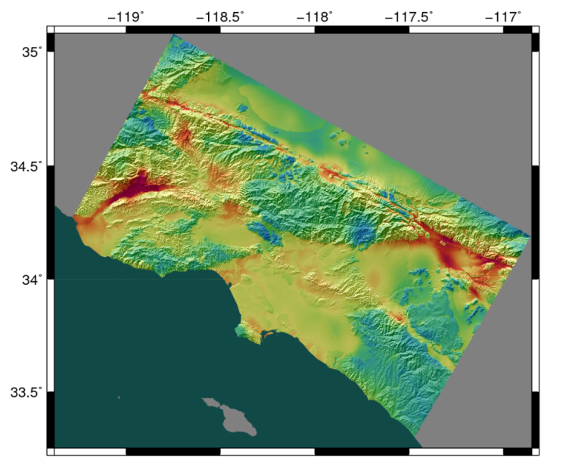
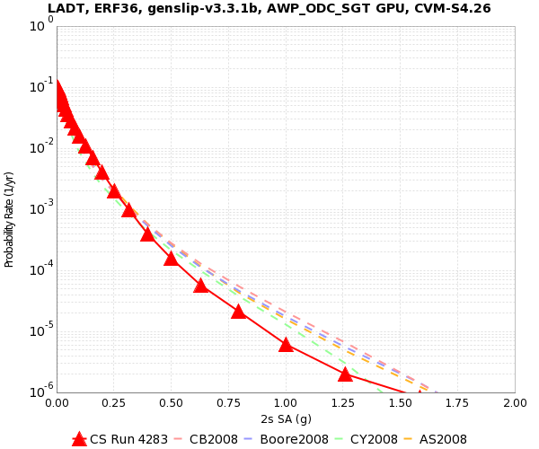
Workflow Application: CyberShake
What will peak ground motion be over the next 50 years?
Used in building codes, insurance, government, planning
Answered via Probabilistic Seismic Hazard Analysis (PSHA)
Communicated with hazard curves and maps
2% in 50 years
0.4 g

Slide 20
CyberShake Computational Requirements
Determine shaking of ~500,000 earthquakes per site
Large parallel jobs
2 GPU wave propagation jobs, 800 nodes x 1 hr, 1.5 TB output
Small serial jobs
500,000 seismogram calculation jobs, 1 core x 4.7 min, 30 GB
Need ~300 sites for hazard map
Decided to use scientific workflows
Automation
Data management
Error recovery

Slide 21
Challenge: Resource Provisioning
For large parallel jobs, submit to remote scheduler
GRAM (or other tool) puts jobs in remote queue
Runs like a normal batch job
Can specify either CPU or GPU nodes
For small serial jobs, need high throughput
Putting lots of jobs in the batch queue is ill-advised
Scheduler isn’t designed for heavy job load
Scheduler cycle is ~5 minutes
Policy limits too
Solution: Pegasus-mpi-cluster (PMC)

Slide 22
Pegasus-mpi-cluster
MPI wrapper around serial or thread-parallel jobs
Master-worker paradigm
Preserves dependencies
HTCondor submits job to multiple nodes, starts PMC
Specify jobs as usual, Pegasus does wrapping
Uses intelligent scheduling
Core counts
Memory requirements
Can combine writes
Workers write to master, master aggregates to fewer files

Slide 23
Challenge: Data Management
Millions of data files
Pegasus provides staging
Symlinks files if possible, transfers files if needed
Transfers output back to local archival disk
Supports running parts of workflows on separate machines
Cleans up temporary files when no longer needed
Directory hierarchy to reduce files per directory
We added automated checks to check integrity
Correct number of files, NaN, zero-value checks
Included as new jobs in workflow

Slide 24
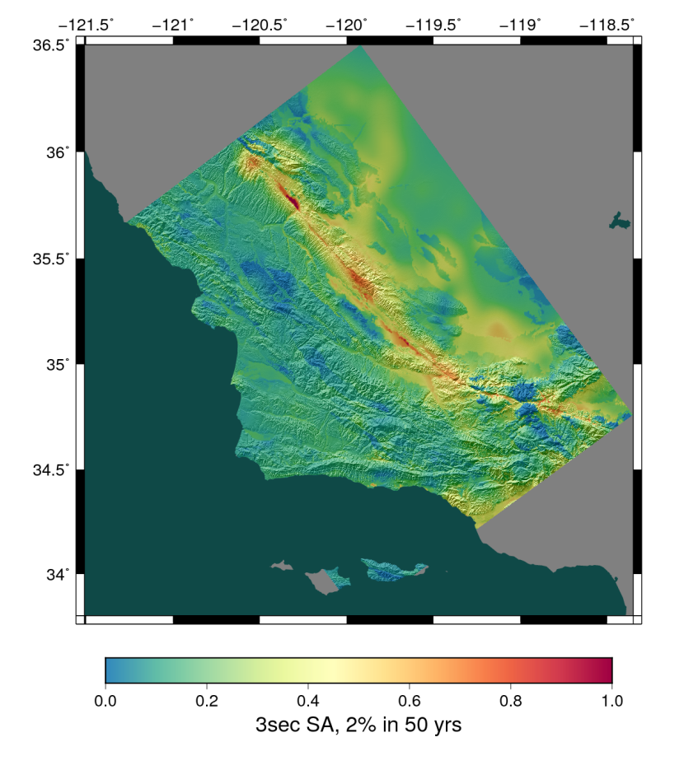
CyberShake Study 17.3
Hazard curves for 876 sites
Used OLCF Titan and NCSA Blue Waters
Averaged 1295 nodes (CPUs and GPUs) for 31 days
Workflow tools scheduled 15,581 jobs
23.9 workflows running concurrently
Generated 285 million seismograms
Workflow tools managed 777 TB of data
308 TB of intermediate data transferred
10.7 TB (~17M files) staged back to local disk
Workflow tools scale!

Slide 25
Problems Workflows Solve
Task executions
Workflow tools will retry and checkpoint if needed
Data management
Stage-in and stage-out data for jobs automatically
Task scheduling
Optimal execution on available resources
Metadata
Automatically track runtime, environment, arguments, inputs
Getting cores
Whether large parallel jobs or high throughput

Slide 26
Should you use workflow tools?
Probably using a workflow already
Replaces manual hand-offs and polling to monitor
Provides framework to assemble community codes
Scales from local computer to large clusters
Provide portable algorithm description independent of data
CyberShake has run on 9 systems since 2007 with same workflow
Does add additional software layers and complexity
Some development time is required

Slide 27
Final Thoughts
Automation is vital, even without workflow tools
Eliminate human polling
Get everything to run automatically if successful
Be able to recover from common errors
Put ALL processing steps in the workflow
Include validation, visualization, publishing, notifications
Avoid premature optimization
Consider new compute environments (dream big!)
Larger clusters, XSEDE/PRACE/RIKEN/CC, Amazon EC2
Tool developers want to help you!

Slide 28
Links
SCEC: http://www.scec.org
Pegasus: http://pegasus.isi.edu
Pegasus-mpi-cluster: http://pegasus.isi.edu/wms/docs/latest/cli-pegasus-mpi-cluster.php
HTCondor: http://www.cs.wisc.edu/htcondor/
Globus: http://www.globus.org/
Swift: http://swift-lang.org
Askalon: http://www.dps.uibk.ac.at/projects/askalon/
Kepler: https://kepler-project.org/
RADICAL Cybertools: https://radical-cybertools.github.io/
UNICORE: http://www.unicore.eu/
CyberShake: http://scec.usc.edu/scecpedia/CyberShake
Notes:
Update links

Slide 29
Questions?

