Slide 1
CyberShake Platform Update
Scott Callaghan
SCEC/PG&E Annual Review Meeting
November 28, 2017

Slide 2
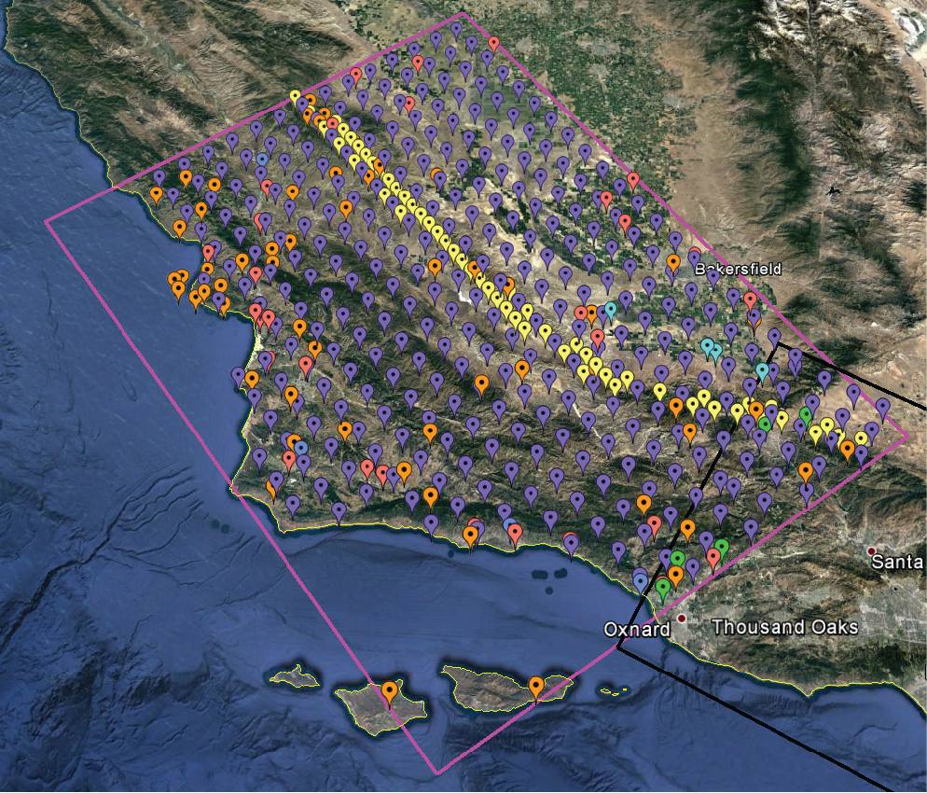
Central California CyberShake
438 sites
PG&E pumping sites
CISN stations
Cities from USGS Gazetteer
Historic missions
10 km regular grid
1.0 Hz
UCERF 2 forecast
Graves & Pitarka 2014 rupture generator
Two velocity models:
CCA 1D (1D averaged)
CCA-06 (3D tomographic)

Slide 3
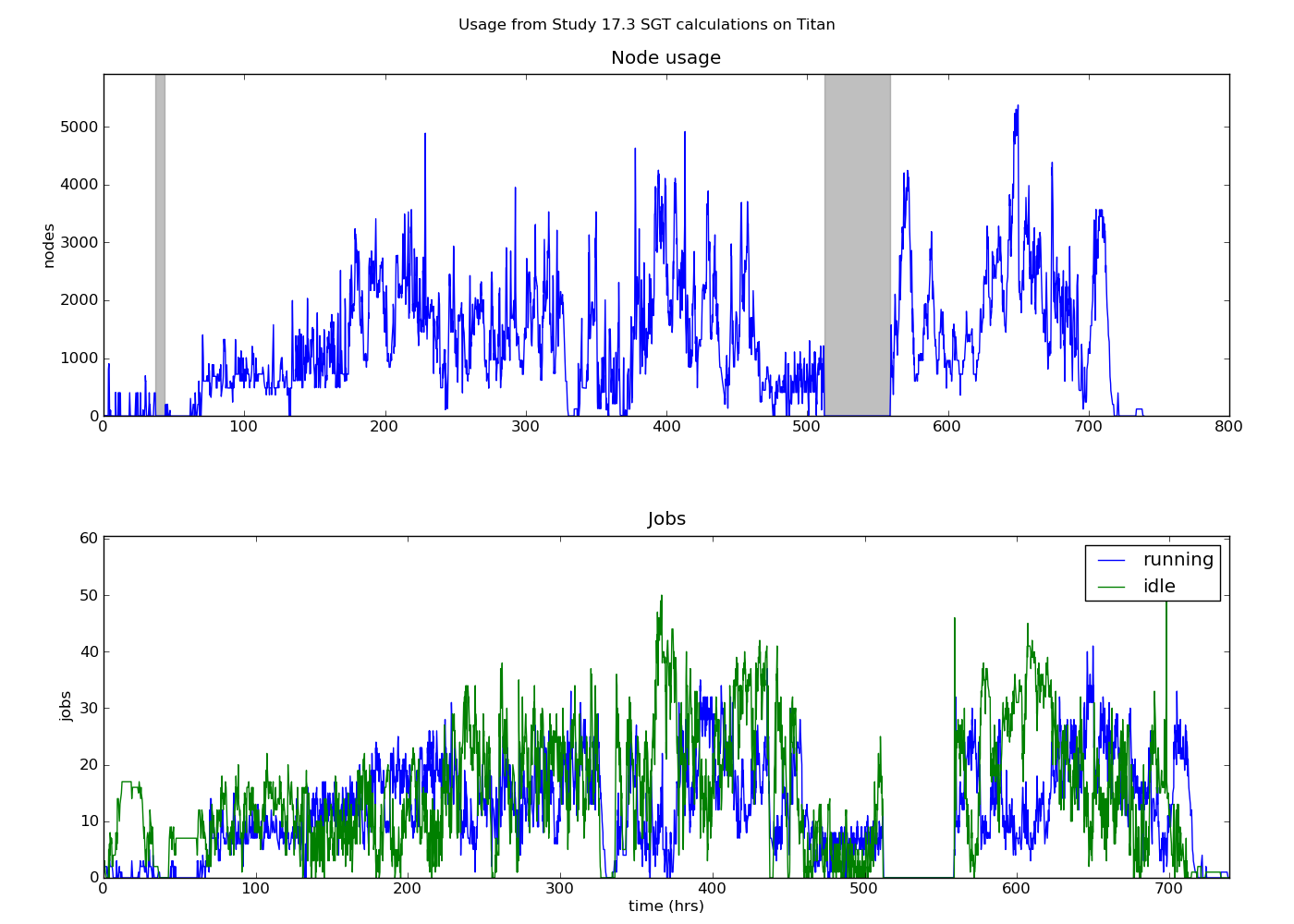
CyberShake Study 17.3
Conducted over 31 days in March-April 2017
2 velocity models at 438 sites
Used two top-5 supercomputers
Consumed 21.6 million core-hrs
Averaged 31,000 core-hrs continually
777 TB of data managed
10.7 TB archived on SCEC disks
Generated 285 million two-component seismograms
43 billion intensity measures
5 billion duration measures

Slide 4
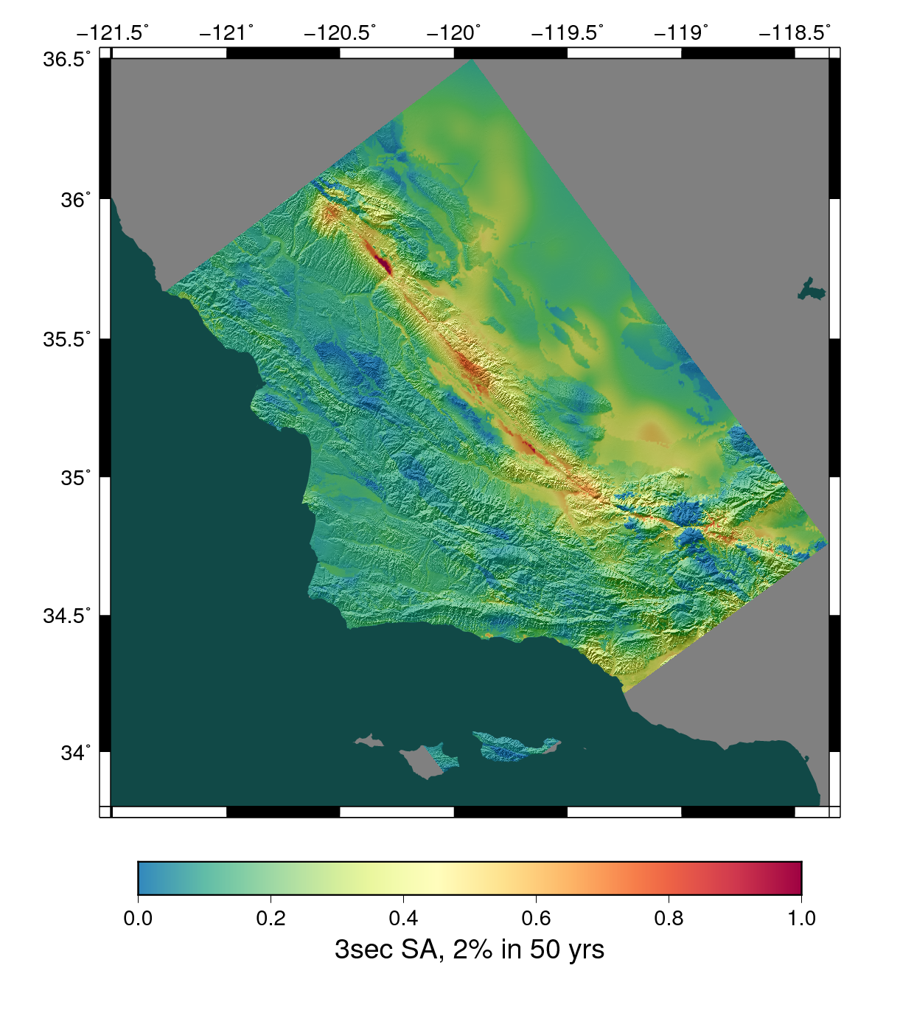
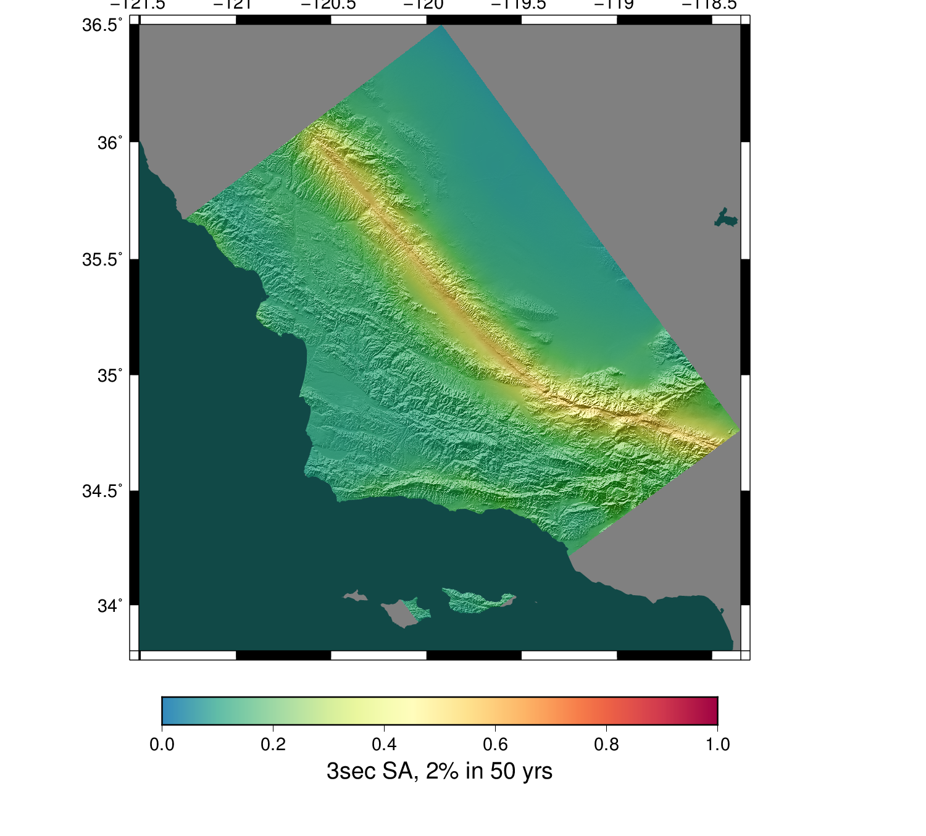
Study 17.3 Results
1D model
3D model

Slide 5
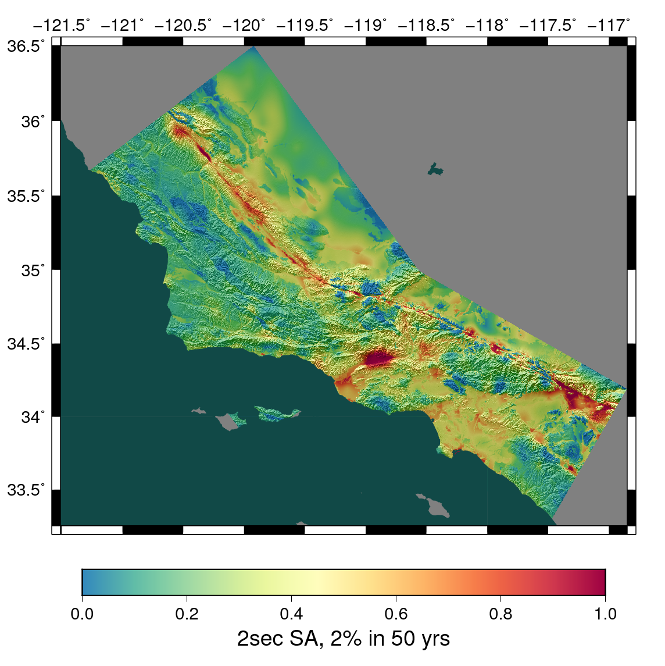
Combined Results
Study 17.3 combined with Southern California CyberShake (Study 15.4)
Represents 50 million core-hrs
Demonstrates CyberShake can be migrated outside of Southern California

Slide 6
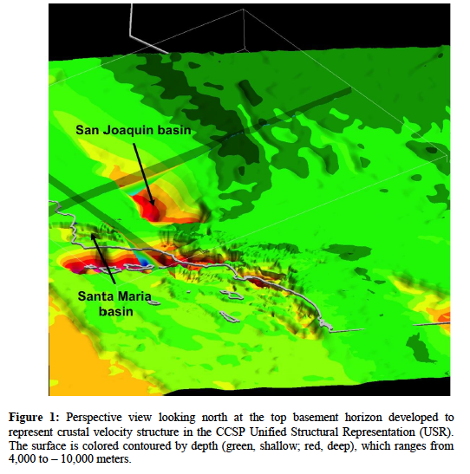
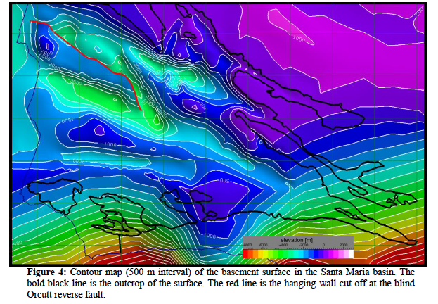
Improving Velocity Model
Integration of Shaw and Plesch CCA basins into velocity model
Work currently underway to bring basins into CCA-06 model for use with CyberShake

