Slide 1
CyberShake Study 18.8 Science Readiness Review
Scott Callaghan

Slide 2
Study 18.8 Scientific Goals
Expand CyberShake to the extended Bay Area.
1 Hz
UCERF 2
Graves & Pitarka (2014) rupture generator
Calculate CyberShake results with a new combination of velocity models.
USGS Bay Area, CCA-06 + Ely-Jordan GTL, CVM-S4.26.M01
Compare Central and Bay Area results at overlapping sites.
Include background seismicity contributions in final hazard estimates

Slide 3
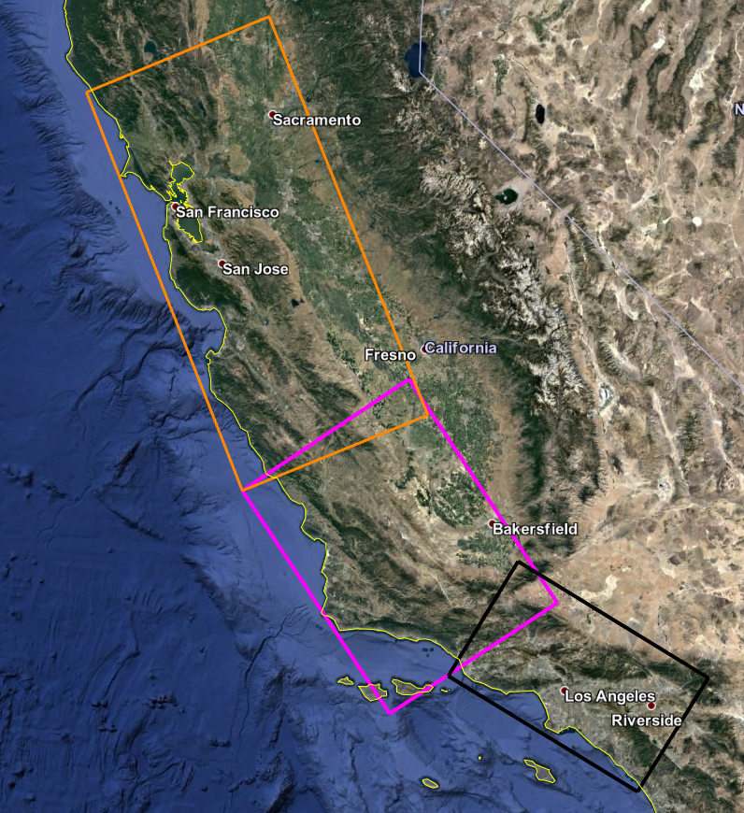
Study Region
Region (orange) selected to continue CyberShake up the coast
180 x 390 km, 27 degrees
Largest region so far
Overlap with Study 17.3 region for comparisons
Sites fall within both CCA-06 and USGS Bay Area velocity models (detailed velocity model discussion to follow)

Slide 4
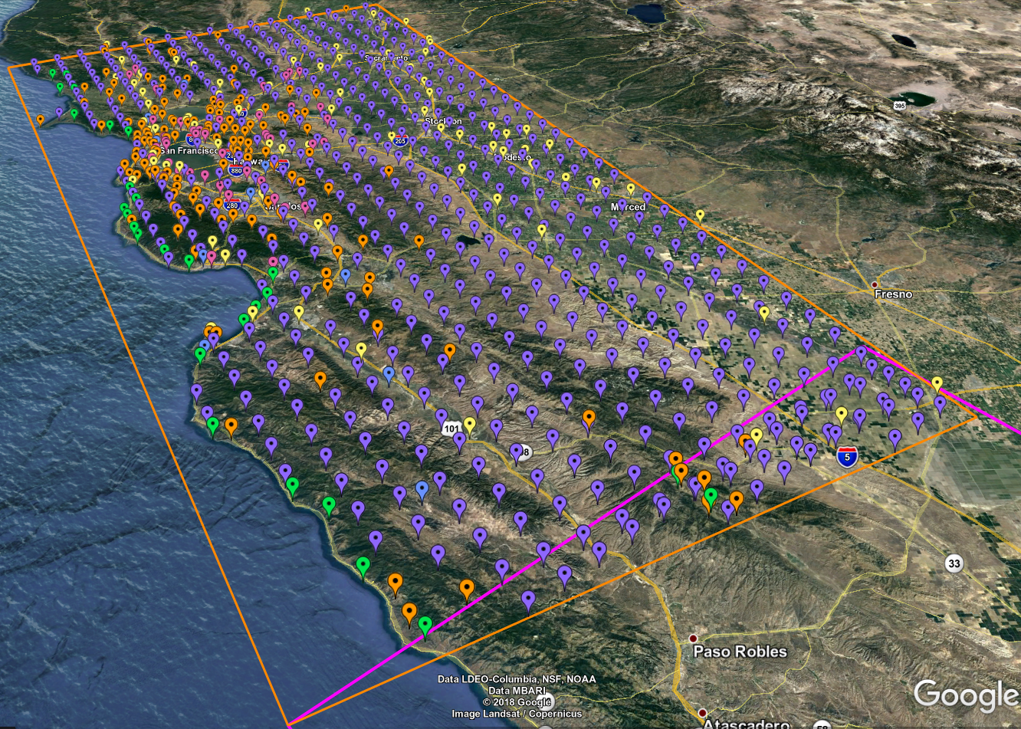
869 Proposed Study sites
10 km spacing (purple)
5 km spacing for greater shore density (green)
CISN stations (orange)
PG&E sites (pink)
Cities (yellow)
Decimation applied to reduce overall number
32 overlapping sites
44% have southern San Andreas events within 200 km

Slide 5
Study 18.8 Data Products
SRF-format rupture descriptions
Two-component seismograms (~195 million)
Intensity measures
Geometric mean at 44 periods (0.1 – 10 sec): 2, 3, 5, 10 sec stored in DB
RotD50 and RotD100 at 22 periods (1 – 10 sec): 2, 3, 4, 5, 7.5, 10 sec stored in DB
Duration metrics
Energy integral, Arias intensity, cumulative absolute velocity
Significant durations (5-75%, 5-95%, 20-80%) for velocity and acceleration
Significant durations (5-75%, 5-95%) for acceleration for X and Y stored in DB
Hazard curves for 869 sites
RotD100 at 2, 3, 4, 5, 7.5, 10 sec
RotD50 at 2, 3, 4, 5, 7.5, 10 sec
Geometric mean at 2, 3, 5, 10 sec
RotD50 hazard maps at 2, 3, 5, 7.5, and 10 sec

Slide 6
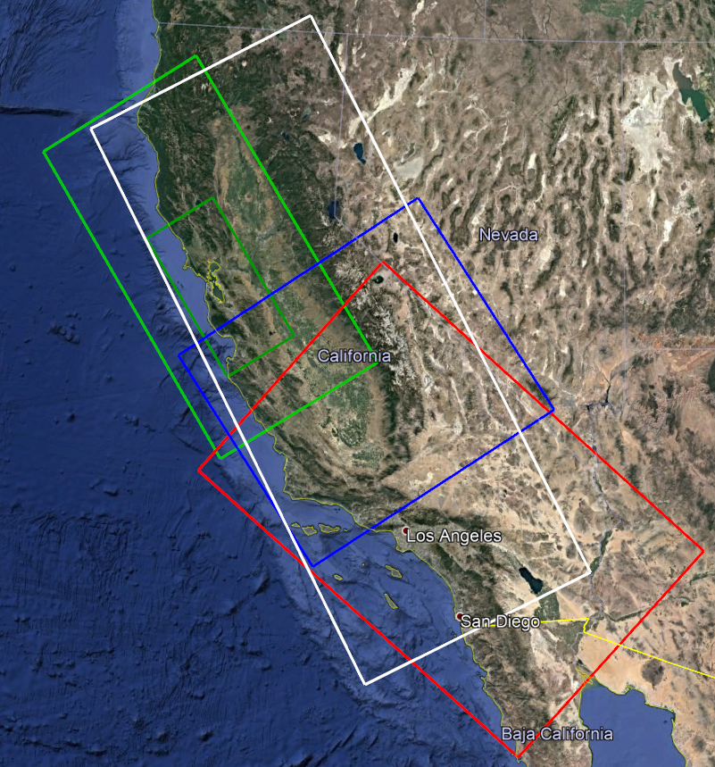
Velocity Models
Simulation region for some sites extends beyond any one model
Angle adjusted from 55 to 30 degrees
Tiling required: order is
CCA-06 model + Ely GTL
USGS Bay Area (includes high-res)
CVM-S4.26.M01
Great Valley basins better represented in CCA-06
Minimum Vs = 500 m/s
White: simulation region
Green: USGS Bay Area Dark Green: USGS Bay Area, high-res
Blue: CCA-06 Red: CVM-S4.26

Slide 7
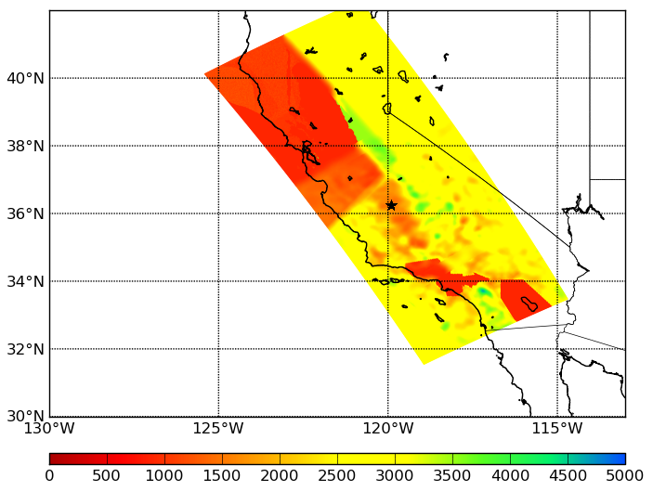
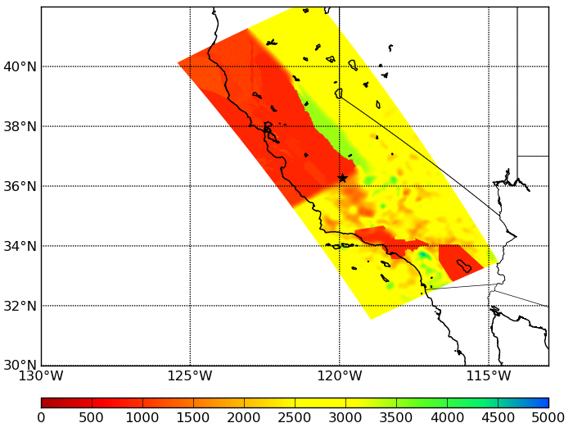
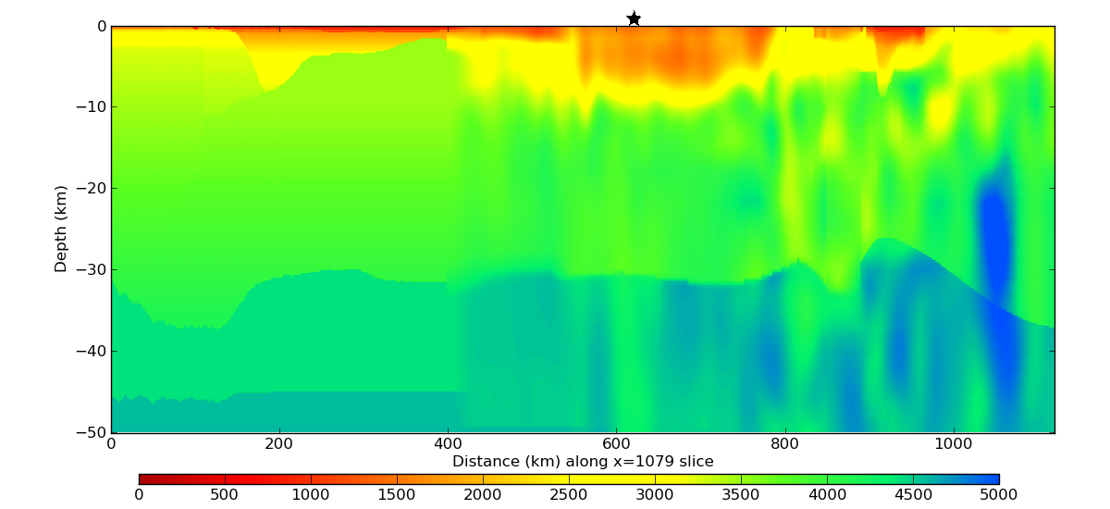
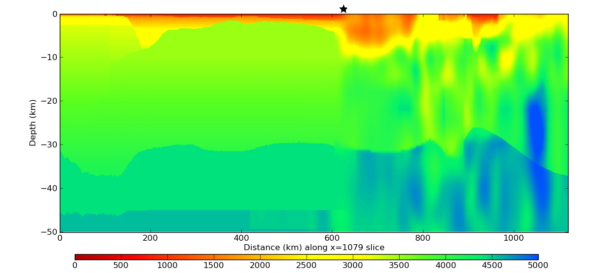
Velocity cross-sections
Proposed tiling
USGS Bay Area first
Surface plot
Cross-section through star

Slide 8
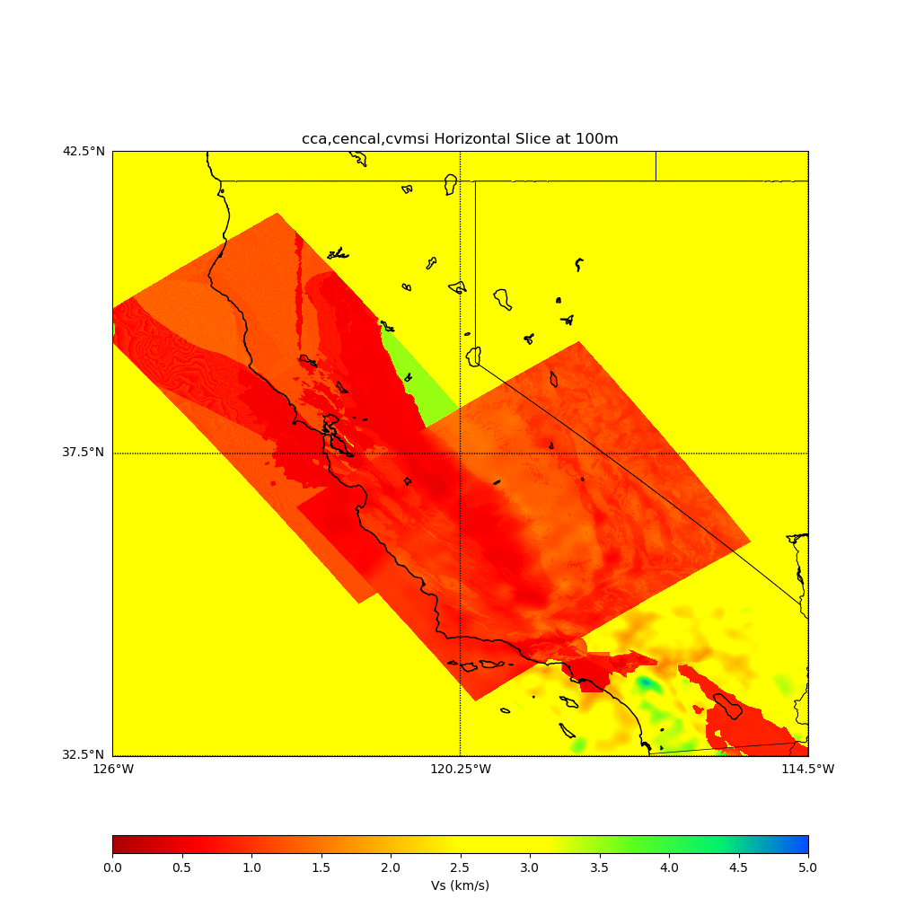
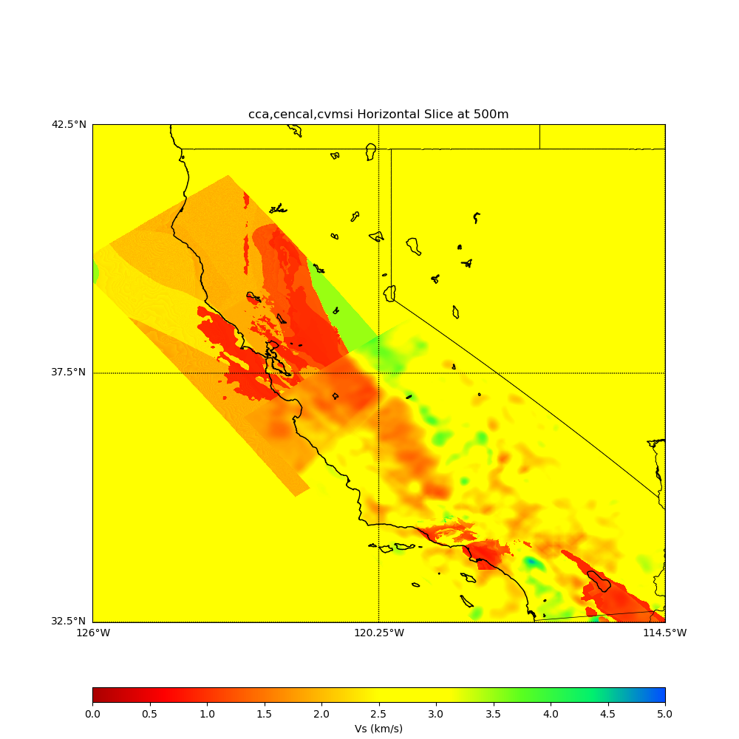
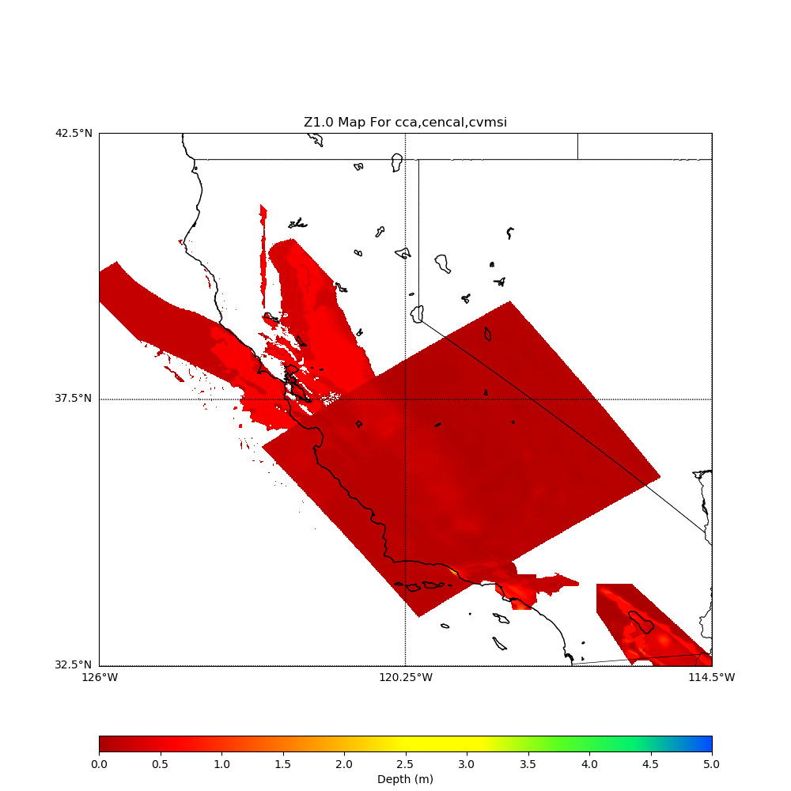
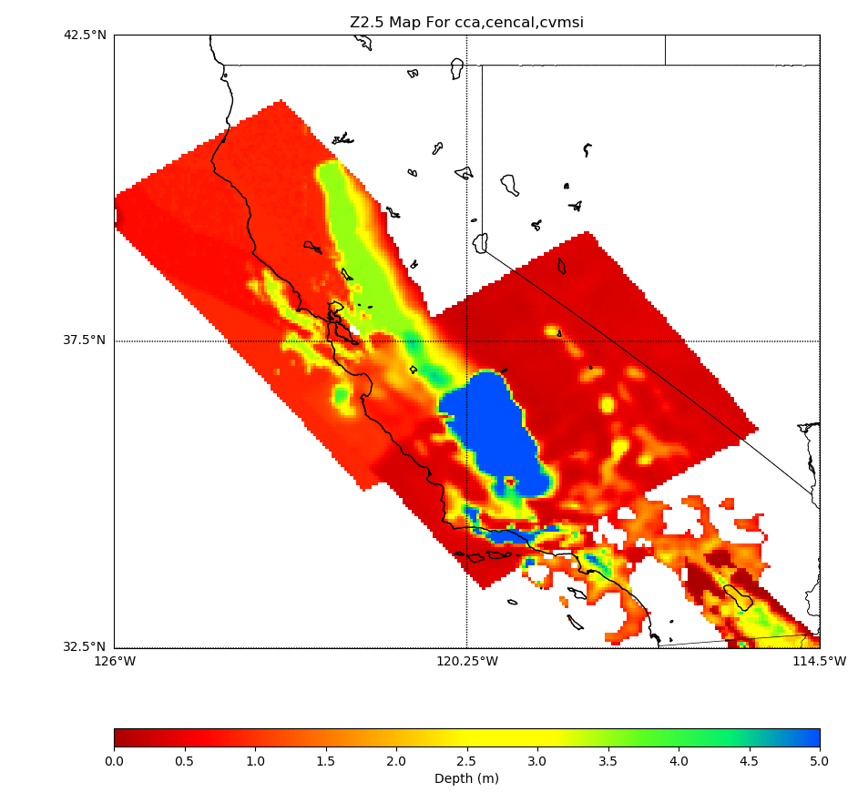
Vs at depth=0m
Vs at depth=100m
Vs at depth=500m
Z1.0
Z2.5

Slide 9
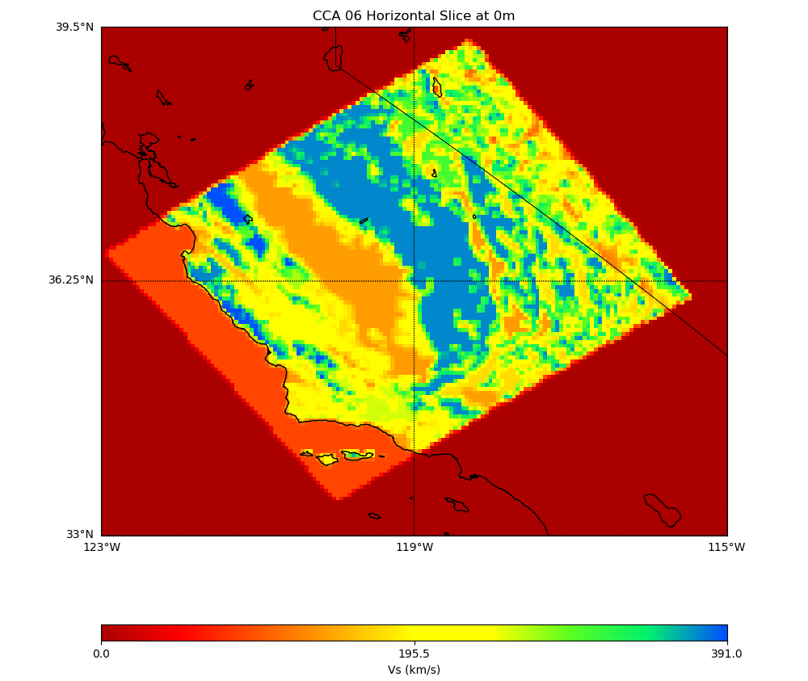
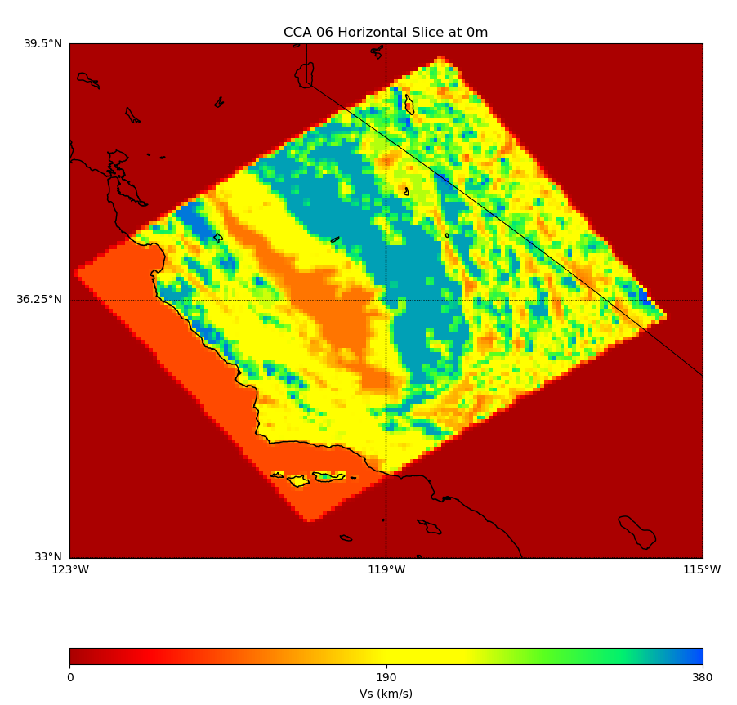
Wills (2015) Vs30
Vs30, using Ely-Jordan GTL and Wills (2015) in CCA-06
Surface Vs using Ely-Jordan GTL and Wills (2006)
Surface Vs using Ely-Jordan GTL and Wills (2015)

Slide 10
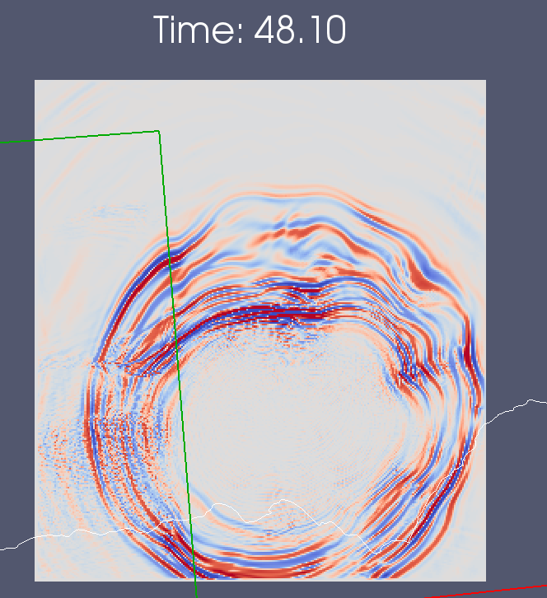
Smoothing
Performed forward sims across model interface: decided on 20 km
Wavefront encounters smoothed region
10 km smoothing
20 km smoothing
20 km smoothing shows reduced refraction effects

Slide 11
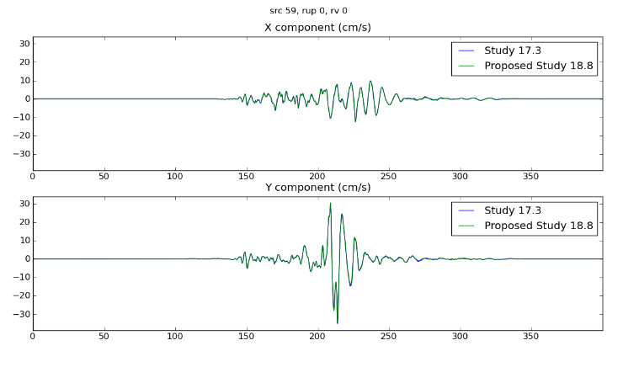
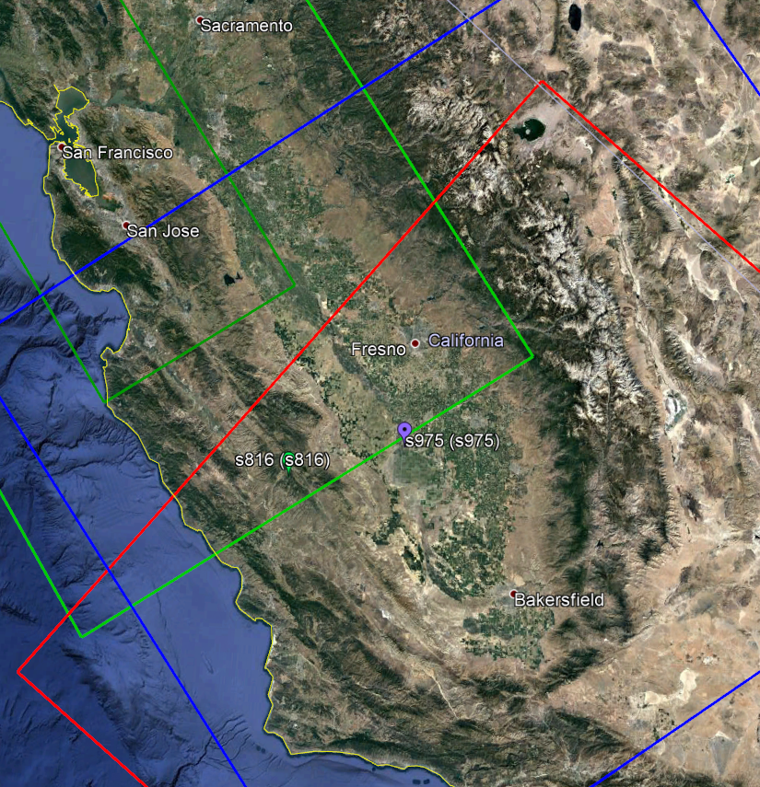
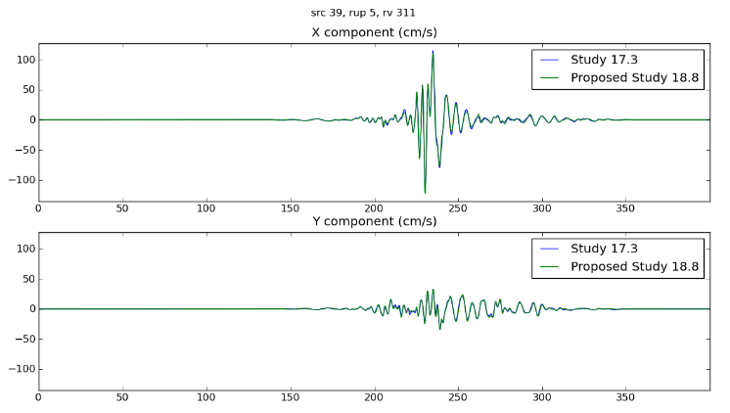
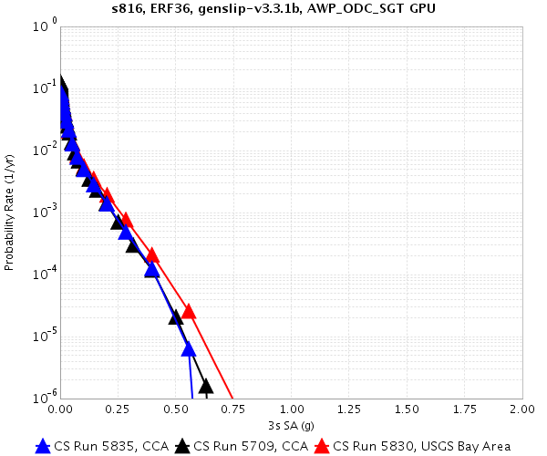
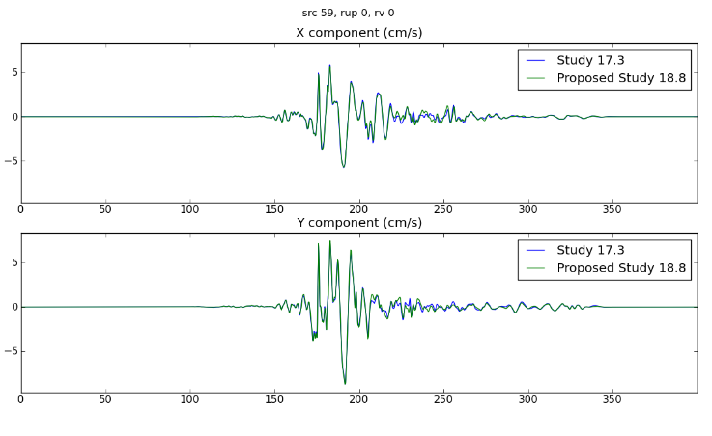
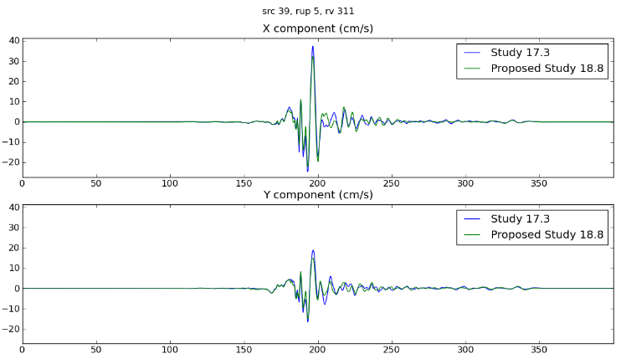
Comparisons with Study 17.3 (Central CA)
Green: USGS Bay Area Dark Green: USGS Bay Area, high-res
Blue: CCA-06 Red: CVM-S4.26

Slide 12
Study 18.8 Parameters
1.0 Hz deterministic
100 m grid spacing
50 km depth (no difference with 80 km depth)
Volumes range from 6 – 25 billion points (210 x 550 km to 450 x 1120 km)
dt = 0.005 sec
SGT nt = 40000 timesteps (200 sec)
Seismogram nt = 8000 timesteps (400 sec)
Source filtered at 2.0 Hz
UCERF 2 ERF
200 m rupture grid point spacing
Graves and Pitarka (2014) rupture variations
2100 – 4600 UCERF2 ruptures become 130K – 350K rupture variations per site

Slide 13
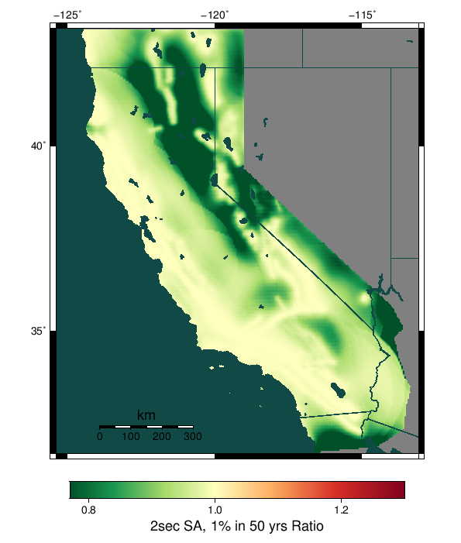
Background Seismicity
Contributions of up to ~10%
We will add background seismicity after the study is complete
exclude / include for UCERF 2

Slide 14
Site order
Full study is 869 sites. Proposed execution order is:
32 Overlapping sites
46 PG&E sites
136 CISN stations
571 grid sites
74 Cities
10 Missions

Slide 15
Computational Plan
Goals are to minimize makespan and human involvement
SGTs: 75% Blue Waters, 25% Titan
1.2M node-hrs on Blue Waters
12.5M SUs on Titan
Post-processing: 75% Blue Waters, 25% Titan
600K node-hrs on Blue Waters
12.6M SUs on Titan
Total of 1.8M node-hrs on BW, 25.1M SUs on Titan
BW has 6.98M node-hrs
Titan has 48.5M Sus
May adjust percentages depending on throughput

Slide 16
Storage Requirements
Titan
Purged: 148 TB temp files + 3 TB output files = 151 TB
Blue Waters
Purged: 589 TB temp files + 9 TB output files = 598 TB
SCEC
12 TB archived (28 TB free on shared SCEC disks)
1 TB workflow logs
360 GB database entries (2.0 TB free on moment.usc.edu disks)

Slide 17
Estimated Duration
Dependent on BW GPU throughput
To complete in 4 weeks before BW allocation expires, must achieve 80% higher usage than during Study 15.4
Planning to request XE and XK reservations and quota increase on Blue Waters
Planning to request queue changes on Titan for higher throughput

Slide 18
Staff
SCEC Staff
Scott Callaghan
Phil Maechling
Christine Goulet
Mei-Hui Su
Kevin Milner
John Yu
Science review
John Vidale
Tom Jordan
Rob Graves
Kim Olsen
Brad Aagaard
Pegasus Staff
Karan Vahi
Mats Rynge
NCSA Staff
Tim Bouvet
Greg Bauer
Galen Arnold
OLCF Staff
Judy HIll

Slide 19
Possible study extensions
Sites using Vs min = 250 m/s
Selected sites with 1D model
Selected sites with finer simulation grids

Slide 20
Study 18.8 Notables
First Bay Area CyberShake calculation
First study with Ely-Jordan GTL applied
Computationally largest study to date
Largest number of sites per map
First study with Wills (2015) Vs30 data

Slide 21
Science to-dos Pending
Calculate a few sites on Blue Waters and compare with Titan results

Slide 22
Risks
GPU throughput on Blue Waters
Blue Waters allocation expiration
Can request extension of the smaller of 5% or 300K node hours

Slide 23
Action Items
Calculate comparison curves on Blue Waters for verification
Have calls with OLCF and NCSA

Slide 24
Thanks for your time!

